Slide 1

Amazon Sales Data Analysis Project Report
- Amisha Nagiya

Slide 2

AGENDA
Problem Statement
Approaches used
Tableau Dashboard
Visualizations and Conclusions
Highlights
Conclusion

Slide 3
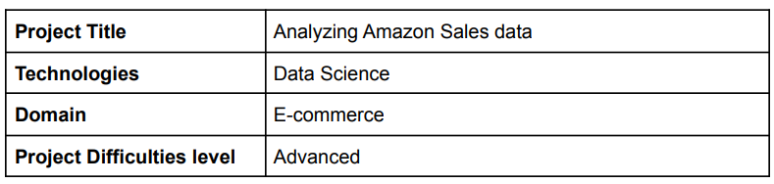

PROBLEM STATEMENT
Sales management has gained importance to meet increasing competition and the need for improved methods of distribution to reduce cost and to increase profits. Sales management today is the most important function in a commercial and business enterprise.
Do ETL: Extract-Transform-Load some Amazon dataset and find for me Sales-trend -> month-wise, year-wise, yearly_month-wise.
Find key metrics and factors and show the meaningful relationships between attributes. Do your own research and come up with your findings.

Slide 4
APPROACHES
PYTHON
Libraries used:
NumPy
Pandas
Matplotlib
Seaborn
TABLEAU
Approaches:
Data Visualizations using the dataset
Creation of sheets and dashboard
Approaches:
ETL
Data Cleaning
Data Visualizations and Analysis

Slide 5

VALUABLE INSIGHTS

Slide 6
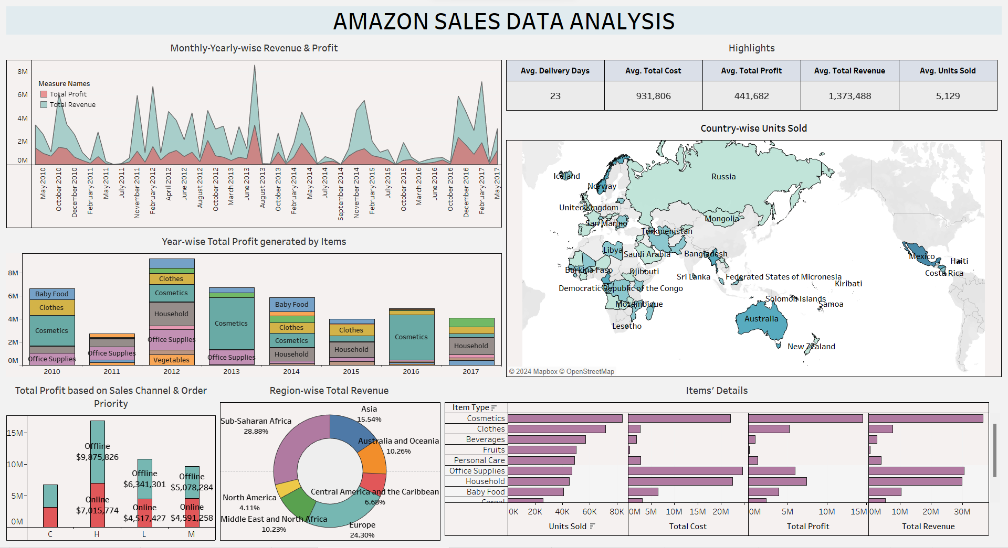

Slide 7
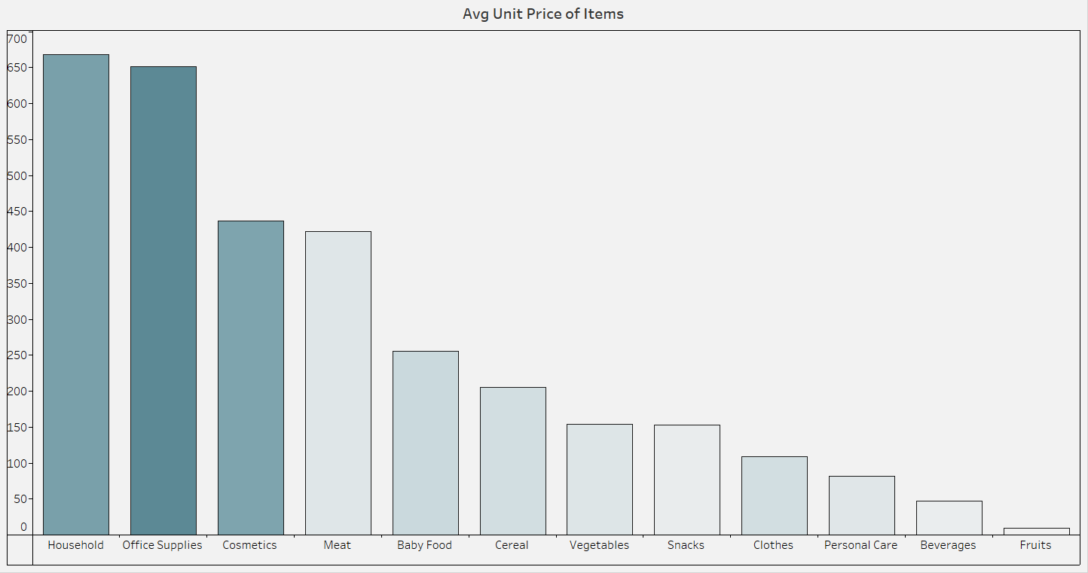
UNIT PRICE OF ITEMS
The order of items having average unit price from highest to lowest is:
Household
Office Supplies
Cosmetics
Meat
Baby Food
Cereal
Vegetables
Snacks
Clothes
Personal Care
Beverages
Fruits

Slide 8
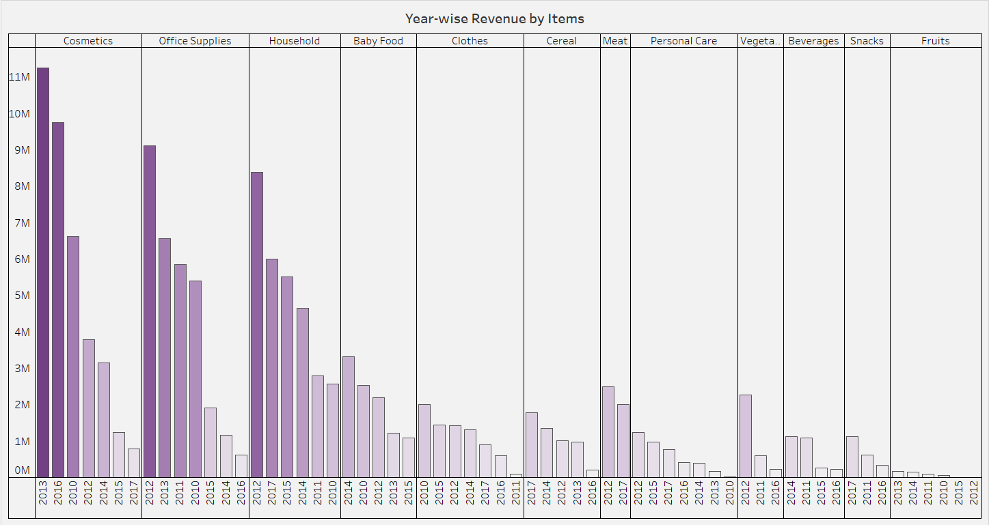
YEAR-WISE REVENUE BY ITEMS

Slide 9
YEAR-WISE REVENUE BY ITEMS
The number of years each items occurred and the order of items based on Total Revenue generated by each item in the specific years are:
1. Cosmetics
Total years: 7, Highest: 2013, Lowest: 2017
2. Office Supplies
Total years: 7, Highest: 2012, Lowest: 2016
3. Household
Total years: 6, Highest: 2012, Lowest: 2010
4. Baby Food
Total years: 5, Highest: 2014, Lowest: 2015
5. Clothes
Total years: 7, Highest: 2010, Lowest: 2011
6. Cereal
Total years: 5, Highest: 2017, Lowest: 2016
7. Meat
Total years: 2, Highest: 2012, Lowest: 2017
8. Personal Care
Total years: 7, Highest: 2012, Lowest: 2010
9. Vegetables
Total years: 3, Highest: 2012, Lowest: 2016
10. Beverages
Total years: 4, Highest: 2014, Lowest: 2016
11. Snacks
Total years: 3, Highest: 2017, Lowest: 2016
12. Fruits
Total years: 6, Highest: 2013, Lowest: 2012

Slide 10
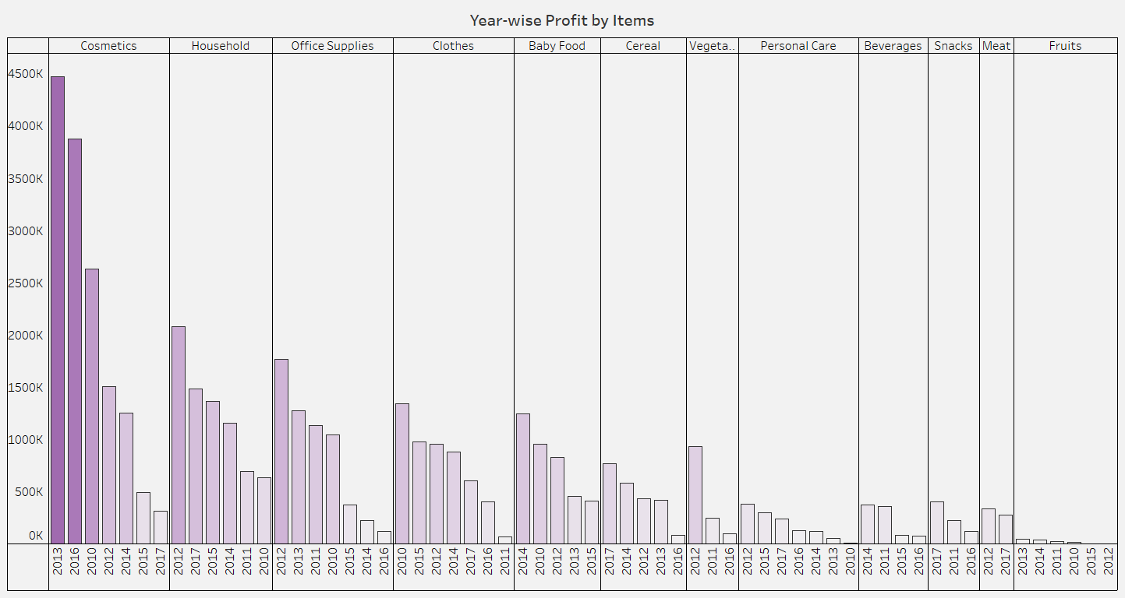
YEAR-WISE PROFIT BY ITEMS

Slide 11
YEAR-WISE PROFIT BY ITEMS
The number of years each items occurred and the order of items based on Total Profit generated by each item in the specific years are:
1. Cosmetics
Total years: 7, Highest: 2013, Lowest: 2017
2. Household
Total years: 6, Highest: 2012, Lowest: 2010
3. Office Supplies
Total years: 7, Highest: 2012, Lowest: 2016
4. Clothes
Total years: 7, Highest: 2010, Lowest: 2011
5. Baby Food
Total years: 5, Highest: 2014, Lowest: 2015
6. Cereal
Total years: 5, Highest: 2017, Lowest: 2016
7. Vegetables
Total years: 3, Highest: 2012, Lowest: 2016
8. Personal Care
Total years: 7, Highest: 2012, Lowest: 2010
9. Beverages
Total years: 4, Highest: 2014, Lowest: 2016
10. Snacks
Total years: 3, Highest: 2017, Lowest: 2016
11. Meat
Total years: 2, Highest: 2012, Lowest: 2017
12. Fruits
Total years: 6, Highest: 2013, Lowest: 2012

Slide 12
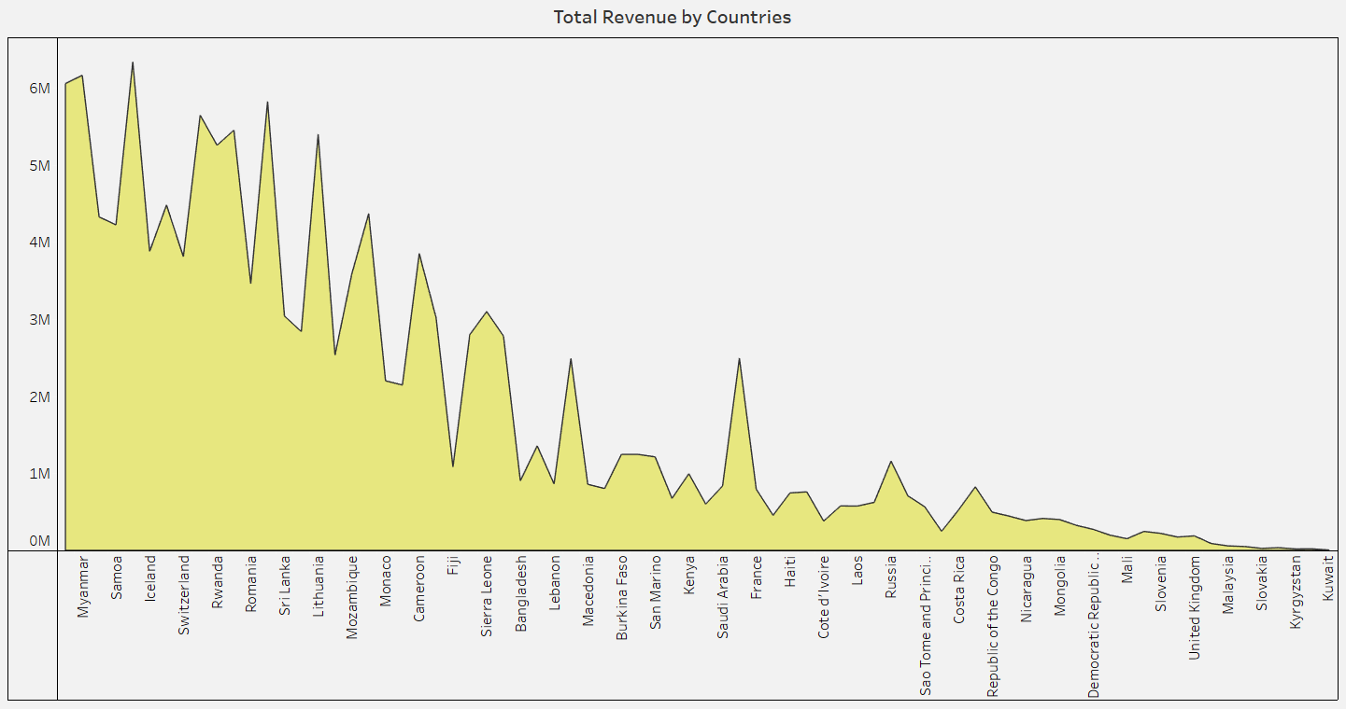
COUNTRY-WISE REVENUE

Slide 13
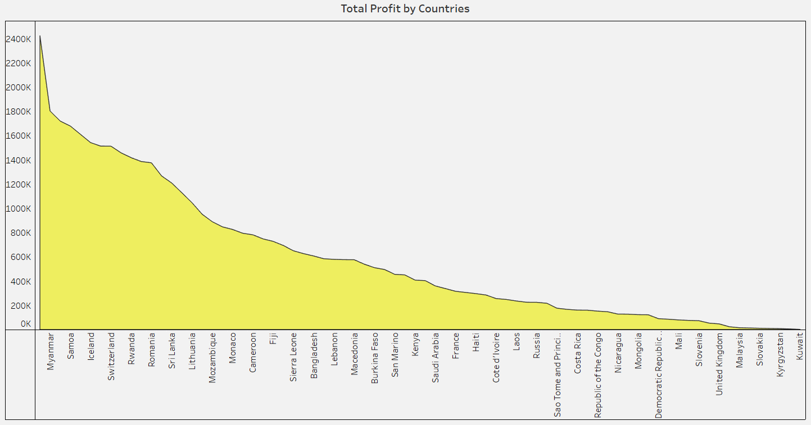
COUNTRY-WISE PROFIT

Slide 14
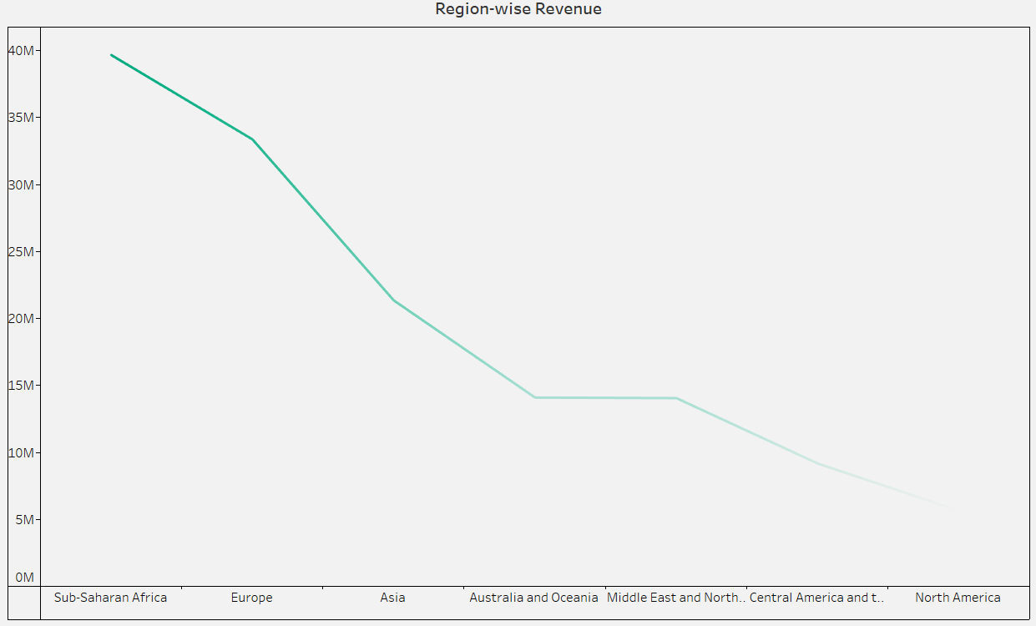
REGION-WISE REVENUE

Slide 15
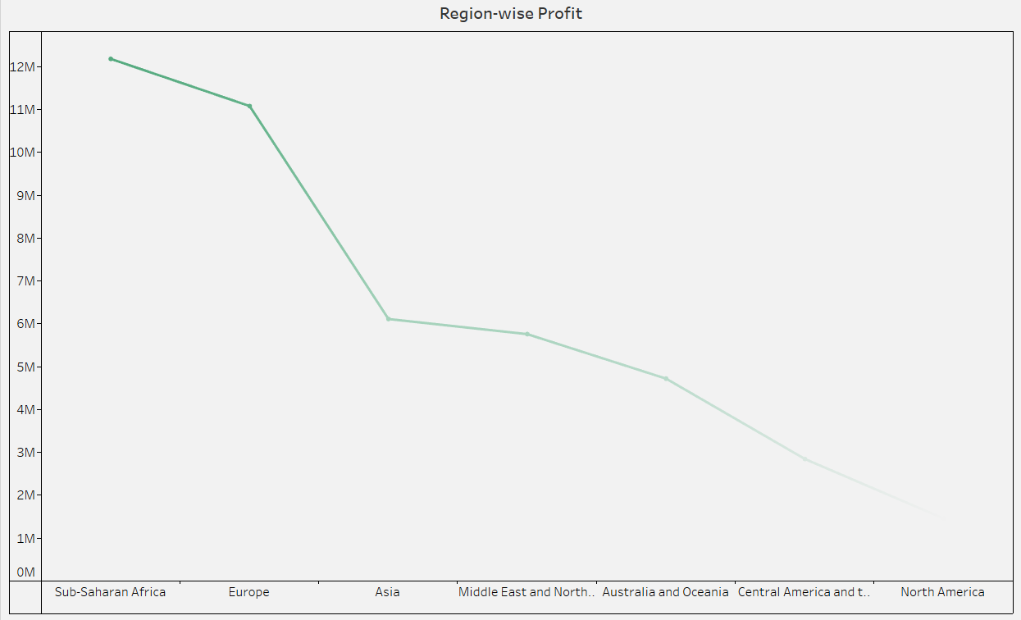
REGION-WISE PROFIT

Slide 16
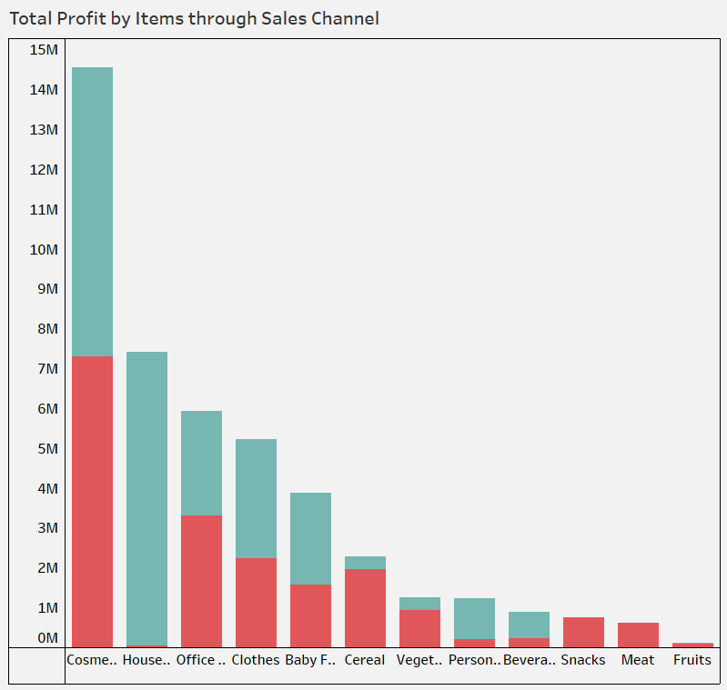

POPULARITY OF ITEMS IN EACH SALES CHANNEL
The highest profit was generated by Cosmetics where in online mode it performed little better.
The least profit was generated by Fruits that too more in online mode.
Out of all, the drastic change can be seen in Household items where the offline mode was the popular choice and in online, it was negligible.
In maximum items, it can be seen that online mode was chosen more than the offline mode.
Snacks and Meat generated zero profit value from offline mode.

Slide 17
HIGHLIGHTS
TOTAL REVENUE : $137,348,768
TOTAL PROFIT : $44,168,198
TOTAL COST : $93,180,570
AVERAGE DELIVERY DAYS: 23
AVERAGE TOTAL COST: $931,806
AVERAGE TOTAL REVENUE: $1,373,488
AVERAGE TOTAL PROFIT: $441,682
AVERAGE UNITS SOLD: 5,129
NO. OF COUNTRIES: 76
NO. OF REGIONS: 7
NO. OF ITEMS: 12
NO. OF SALES CHANNEL: 2
NO. OF ORDER PRIORITIES: 4
YEARS INVOLVED: 2010-2017

Slide 18
HIGHLIGHTS
Total Revenue
Top 3 countries:
Djibouti
Myanmar
Pakistan
Bottom 3 countries:
Kuwait
New Zealand
Kyrgyzstan
Total Profit
Top 3 countries:
Djibouti
Myanmar
Pakistan
Bottom 3 countries:
Kuwait
New Zealand
Kyrgyzstan
Total Revenue
Top 3 regions:
Sub-Saharan Africa
Europe
Asia
Bottom 3 countries:
North America
Central America and the Caribbean
Middle East and North Africa
Total Profit
Top 3 regions:
Sub-Saharan Africa
Europe
Asia
Bottom 3 countries:
North America
Central America and the Caribbean
Australia and Oceania

Slide 19
HIGHLIGHTS
TOTAL COST
Top 3 products:
Office Supplies
Household
Cosmetics
Bottom 3 products:
Fruits
Snacks
Beverages
REVENUE GENERATION
Top 3 products:
Cosmetics
Office Supplies
Household
Bottom 3 products:
Fruits
Snacks
Beverages
PROFIT EARNED
Top 3 products:
Cosmetics
Household
Office Supplies
Bottom 3 products:
Fruits
Meat
Snacks

Slide 20
HIGHLIGHTS
TOTAL COST
Top 3 years:
2012
2013
2010
Bottom 3 years:
2016
2011
2015
REVENUE GENERATION
Top 3 years:
2012
2013
2010
Bottom 3 years:
2011
2016
2015
PROFIT EARNED
Top 3 years:
2012
2013
2010
Bottom 3 years:
2011
2015
2017

Slide 21
CONCLUSION
Some of the strategies that can be used further are:
Optimizing Pricing Strategy
Expanding product offerings
Investing in customer support and retention
Embracing new technologies
Introducing discounts, deals and offers
Focusing more on the bottom categories
Continuously monitoring and adapting
Data security and storage
Improving website performance
Partnerships and alliances
Automated marketing and sales automation
Market analysis and localized marketing
Investing in brand building
Scaling gradually

Slide 22
Thank you ☺

